Slide 1
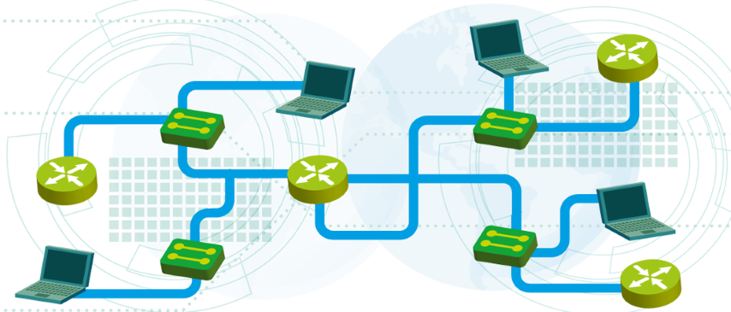

Dynamic routing with OSPF
Module 6
SoftUni Team
Technical Trainers
Software University
http://softuni.bg

Slide 2
Questions
sli.do #NetFund

Slide 3
Table of Contents
Introduction to dynamic routing
OSPF introduction
Single area OSPF configuration

Slide 4
Introduction to dynamic routing

Slide 5
Static vs dynamic routing
Static routing:
Routes to destination networks configured manually
Routing tables not updated if there is better route or lost network
Big administrative overhead, hard to manage
Dynamic routing:
Routers dynamically exchange the networks they know about
Routing tables are created with the best routes to destinations
Routing tables dynamically create or remove entries

Slide 6
Distance-vector vs link-state protocols
Distance-vector protocols
Designed for small networks
Not scalable
Examples: RIP, IGRP, BGP
Link-state protocols
Designed for small, medium and large networks
Can scale
Examples: OSPF, IS-IS

Slide 7
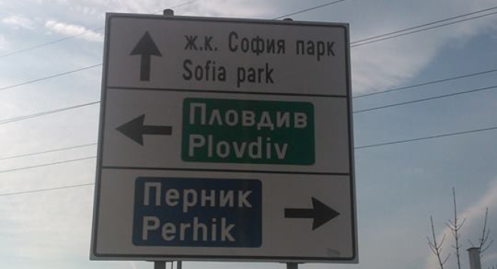
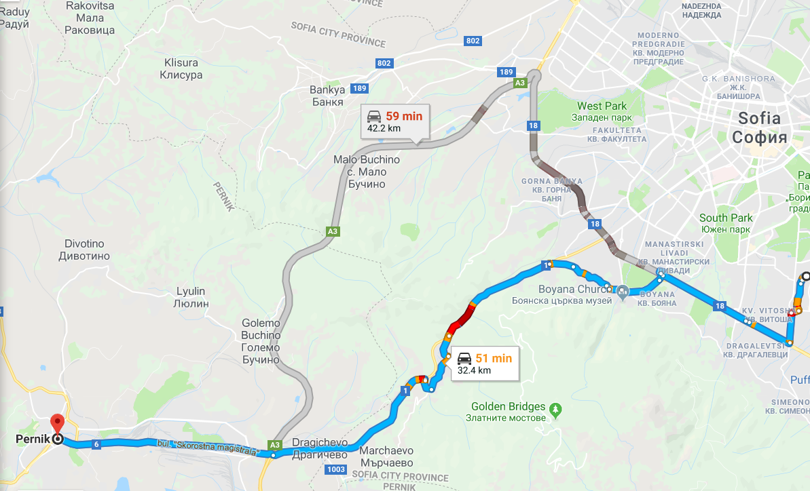
Distance-vector vs link-state protocols (2)
Distance-vector protocols
Link-state protocols

Slide 8
RIP vs OSPF
RIP: Routing Information Protocol
not efficient in the communication (uses broadcast, sends only periodic updates in v1)
classful protocol (by default)
Uses hop count as a metric
OSPF: Open Shortest Path First
very efficient (uses multicast, sends triggered updates)
classless protocol (but can summarize)
uses cost as a metric

Slide 9
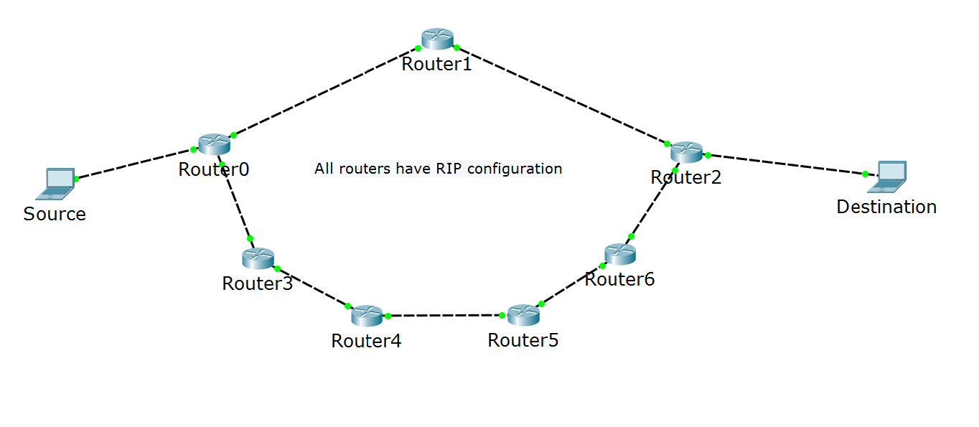
RIP Metric: hop count
Note: all routers talk RIP
I know how to reach Destination!
I will use Router1!
I know how to reach Destination!

Slide 10
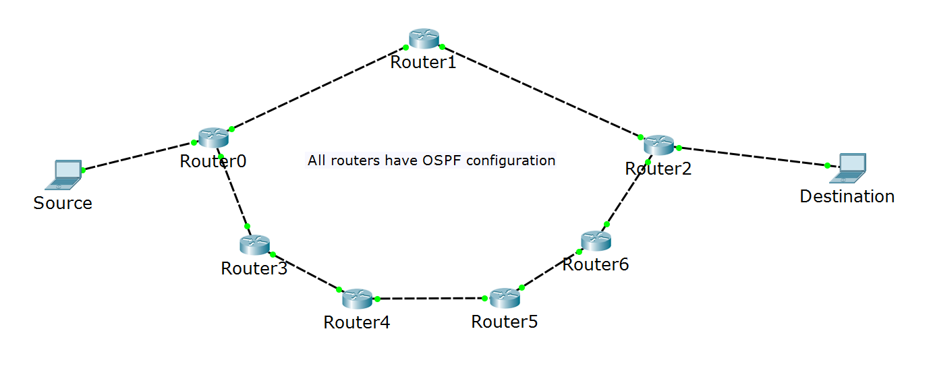
OSPF Metric: cost
Note: all routers talk OSPF
I know how to reach Destination!
I will use Router3!
slow links
fast links
I know how to reach Destination!

Slide 11
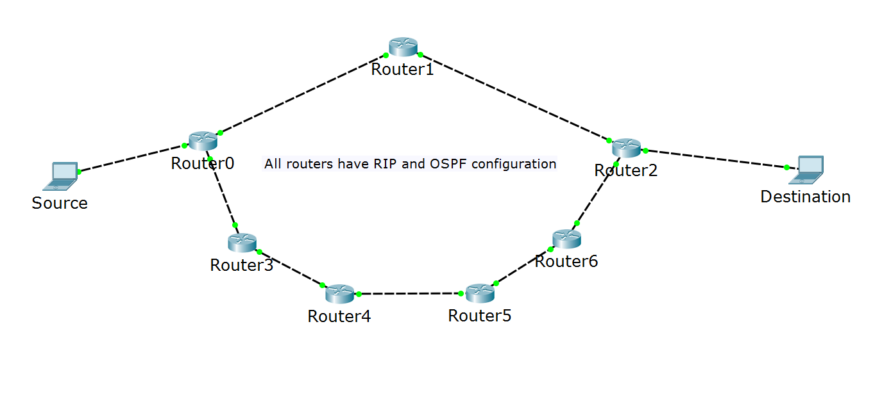
Multiple protocols in the same network
Note: all routers talk RIP and OSPF
RIP: I am better to reach Destination!
?
slow links
fast links
OSPF: I am better to reach Destination!

Slide 12
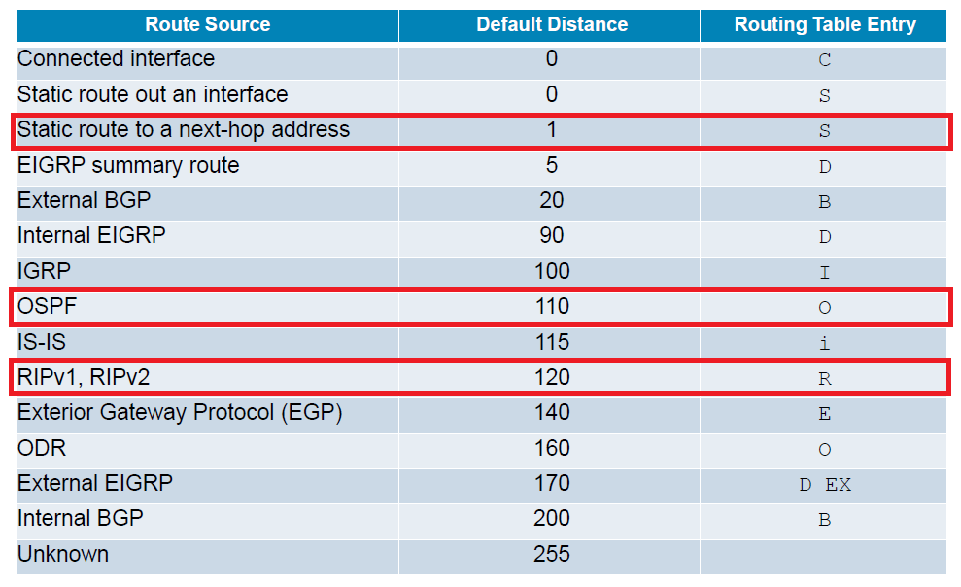
Administrative distance

Slide 13
Questions
sli.do #NetFund

Slide 14
OSPF introduction

Slide 15
OSPF advantages
Fast convergence with triggered updates
Hierarchical structure (areas)
VLSM support (classless protocol)
Efficient communication with neighbors
Uses intelligent metric (cost)
Open standard

Slide 16
OSPF disadvantages
Requires more RAM and CPU on the devices – maintains different tables (neighbor, topology, routing)
Requires good and careful design when multiple areas are needed
More complex to configure and troubleshoot

Slide 17
OSPF terms
LSA – Link State Advertisement
Router ID
Area
ABR – Area Border Router
Autonomous system
ASBR – Autonomous System Boundary Router

Slide 18
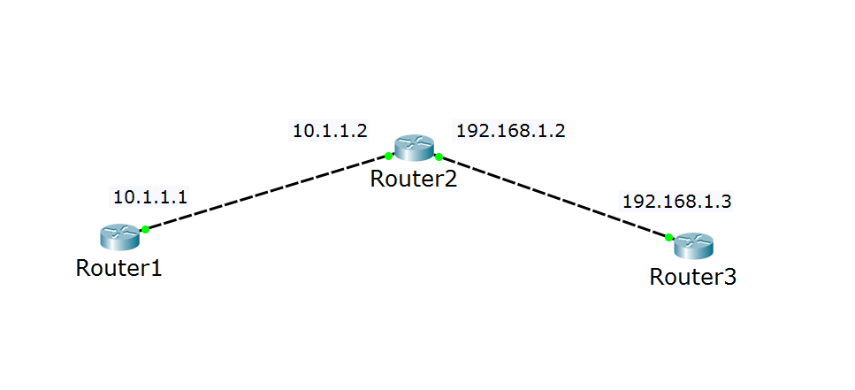
OSPF terms: router ID
I have many names (interfaces), but just call me 2.2.2.2
Hi, 2.2.2.2!
Hi, 2.2.2.2!

Slide 19
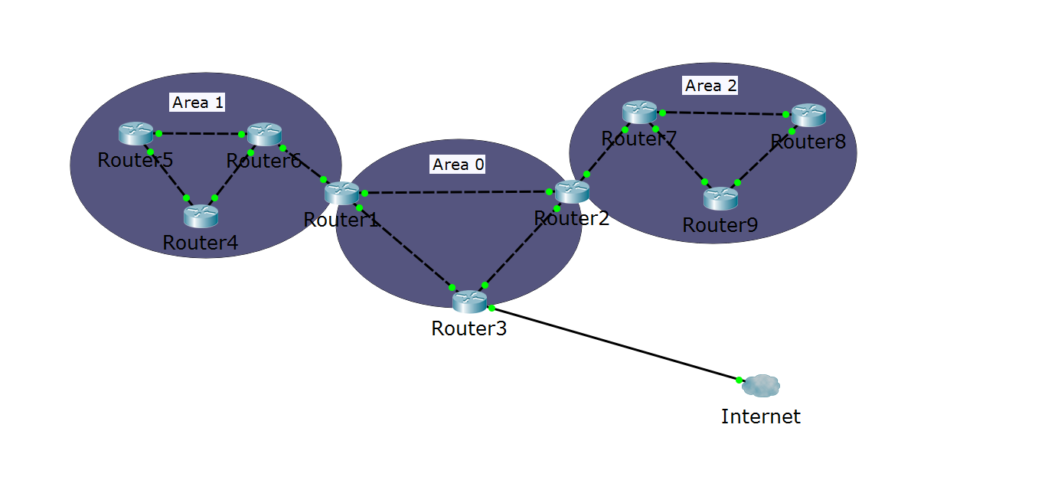
OSPF terms (2)
Autonomous system
ABR
ABR
ASBR
Area 0 = the backbone area

Slide 20
Wildcard masks
In the subnet masks, 1 means “do care” and 0 means “don’t care”
Examples:
192.168.1.0 255.255.255.0 -> refers to 192.168.1.0 network
Loopback address: 10.1.1.1 255.255.255.255 -> exact IP address
In the wildcard masks, 0 means “do care” and 1 means “don’t care”
Examples:
192.168.1.0 0.0.0.255 -> refers to 192.168.1.0 network
Loopback address: 10.1.1.1 0.0.0.0 -> exact IP address

Slide 21
Process ID
router ospf process-id
Has a local significance only – the numbers does not have to match between the routers
Separates processes as they are different routing protocols
It is rarely necessary to have more than 1 process on a router

Slide 22
The “network” command
The network A.B.C.D Wildcard_Mask command makes two things:
It enables the interface (sends OSPF “Hello” messages)
It advertises the network (“I know about network A.B.C.D”) to all OSPF enabled interfaces

Slide 23
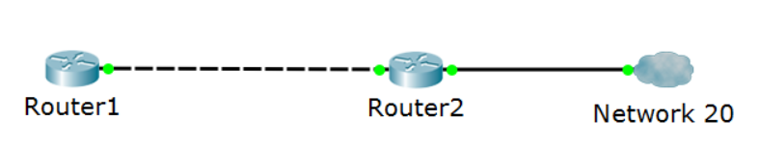


The “network” command (2)
R1:
network 10.0.0.0 0.0.0.255
20.0.0.1
10.0.0.1
10.0.0.2
R2:
network 10.0.0.0 0.0.0.255
network 20.0.0.0 0.0.0.255
Hello!
Hello!
I have network 10!
I have network 10!
…and 20!
Hello!
I have network 10 and 20!

Slide 24
Questions
sli.do #NetFund

Slide 25
Single area OSPF configuration

Slide 26
Single area OSPF configuration
Minimum configuration:
router ospf process_id
router-id number (optional)
network A.B.C.D wildcard_mask area number
Example:
router ospf 1
router-id 1.1.1.1 (optional)
network 192.168.1.0 0.0.0.255 area 0
network 10.0.0.0 0.0.0.255 area 0

Slide 27
OSPF passive interface
The “network” command advertises the network AND sends hello messages out of the interface
What if there is non-OSPF device on the other end of the link?
The Hello packets will be useless
Represents security issues
One solution: use passive interfaces

Slide 28
OSPF passive interface (2)
R1:
network 10.0.0.0 0.0.0.255
20.0.0.1
10.0.0.1
10.0.0.2
G0/1
R2:
network 10.0.0.0 0.0.0.255
network 20.0.0.0 0.0.0.255
Hello!
Hello!
I have network 10!
I have network 10!
…and 20!
Hello!
passive-interface G0/1
I have network 10 and 20!

Slide 29
Useful OSPF commands
show ip ospf interface
show ip ospf neighbor
show run | begin ospf
show ip route [ospf]

Slide 30
Tracing a route for a packet
Some tips to check which path a packet will take in a multi-path L3 network:
show ip route – to check a router’s routing table
tracert A.B.C.D (from Windows)
traceroute A.B.C.D (from Cisco)
*Use the Packet Tracer simulation mode
* not applicable in real networks

Slide 31
Questions
sli.do #NetFund

Slide 32
Demonstration

Slide 33

Summary
Introduction to dynamic routing
2. OSPF introduction
3. Single area OSPF configuration
…
…
…

Slide 35






СофтУни диамантени партньори

Slide 36






СофтУни диамантени партньори

Slide 37





Trainings @ Software University (SoftUni)
Software University – High-Quality Education, Profession and Job for Software Developers
softuni.bg
Software University Foundation
http://softuni.foundation/
Software University @ Facebook
facebook.com/SoftwareUniversity
Software University Forums
forum.softuni.bg

